Slide 1

Lakshmi Narain College Of Technology & Science,
Bhopal
WATERMARKING
Project Guide:
Asst. Prof. : Atul Gupta
Presented By:
Abhay Lunkad (0157CS131002)

Slide 2
Table of Contents
Project Objectives
Watermarking definition
Types of watermarks
Example
Attacks on Watermarks
Desired Characteristics of Invisible Watermarks
7. Advantages & Disadvantages
8. Conclusion

Slide 3
Project Objectives
This project is used for copyright protection of image
& for security purpose.
This project is also used for Data Hiding,Data
authentication,Secure data transmission.

Slide 4
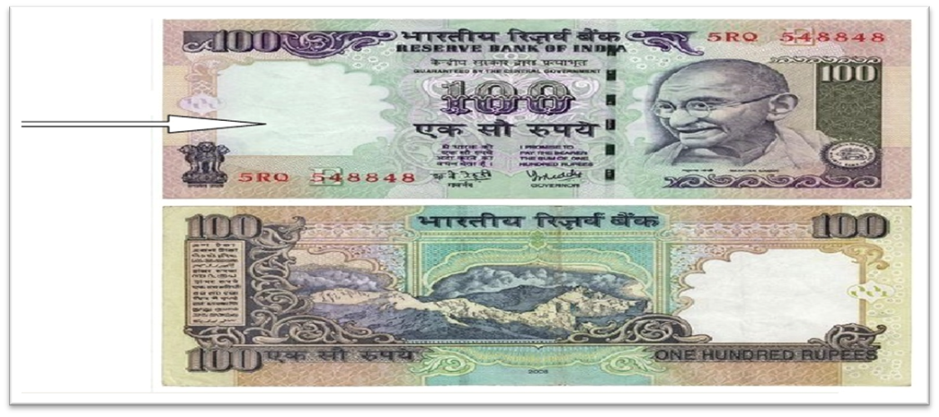
What is Watermark?
Image showing an INR 100 note having watermark at its left side which is
considerably visible when note hold under light
Thus, watermarking is defined as, “the process of possibly irreversibly embedding information into a digitalsignal. The signal may be audio, pictures or video”.

Slide 5
Watermarking in General
The 3 components:
Watermark
Encoder
– watermark insertion
Decoder and Comparator
– watermark extraction and verification

Slide 6
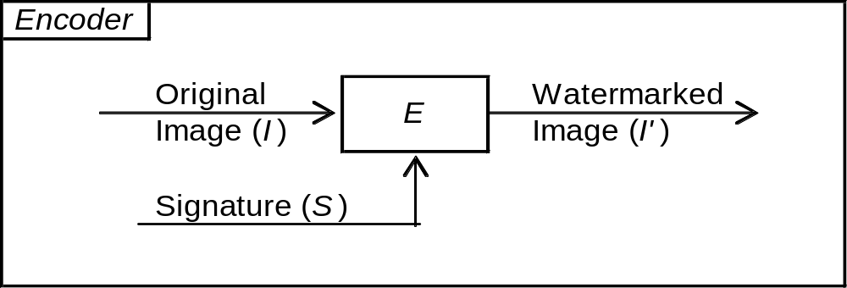
Watermarking in General
the 3 components:
Watermark
Encoder
Decoder and Comparator
Figure provided by Mohanty [2].

Slide 7
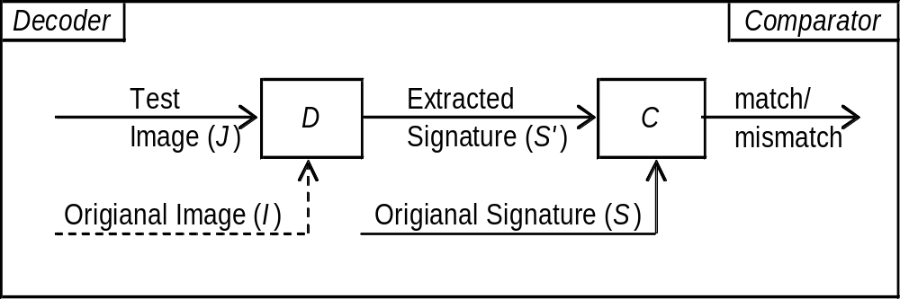
Watermarking in General
Uses 3 components:
Watermark
Encoder
Decoder and Comparator
Figure provided by Mohanty [2].

Slide 8
Types Of Watermarks
Visible watermark
Invisible watermark

Slide 9
Visible Watermarking
Visible watermark is a secondary translucent overlaid into the primary image. The watermark appears visible to a casual viewer on a careful inspection

Slide 10
Invisible watermark
The invisible watermarking, Watermark is embedded in such a way that any alteration made in pixel values are not noticed and it can be recover with appropriate decodeing mechanism.

Slide 11
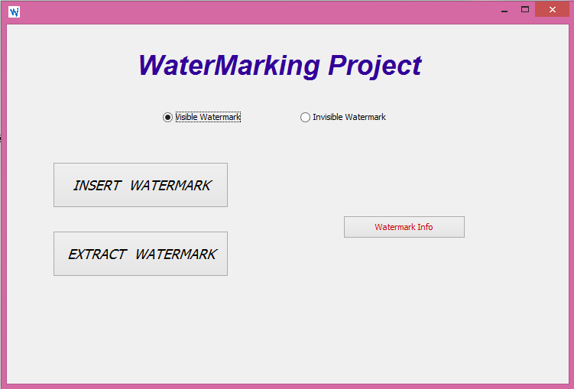
Initial Page

Slide 12
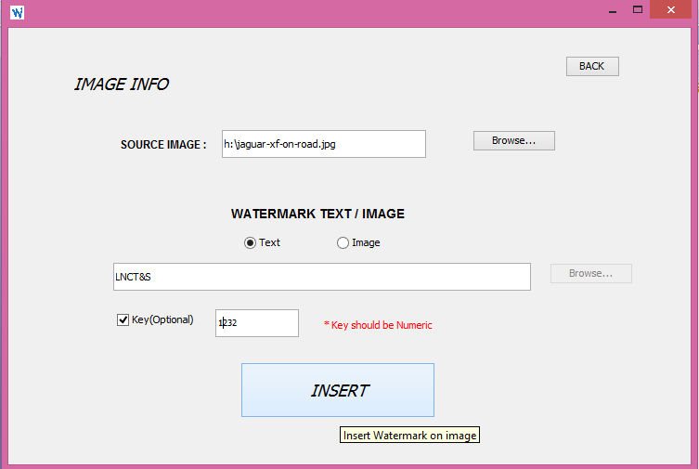
Insertion of Watermark

Slide 13
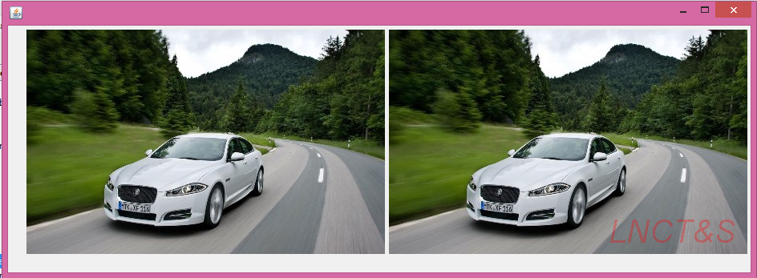
Text Watermark

Slide 14
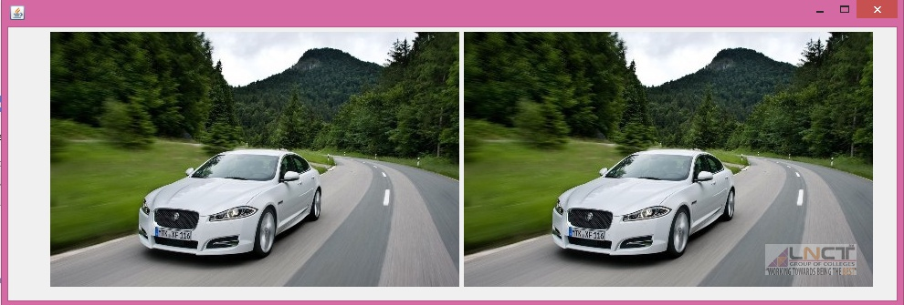
Image Watermark

Slide 15
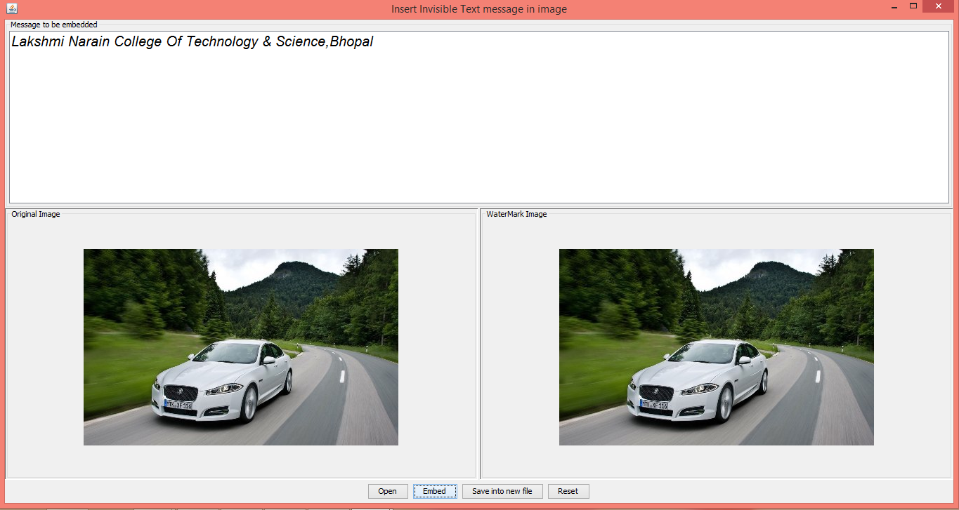
Insertion of Invisible Watermark

Slide 16
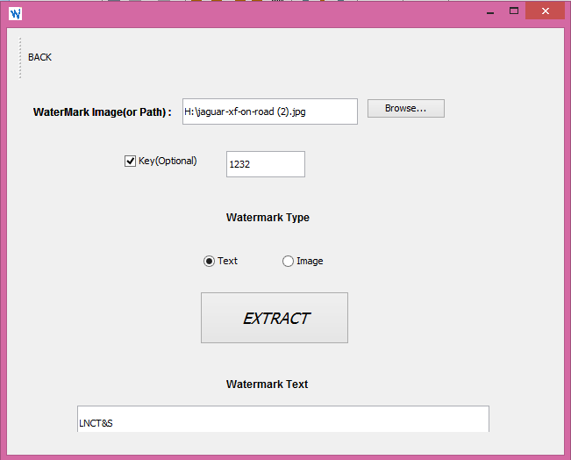
Extraction of Watermark

Slide 17
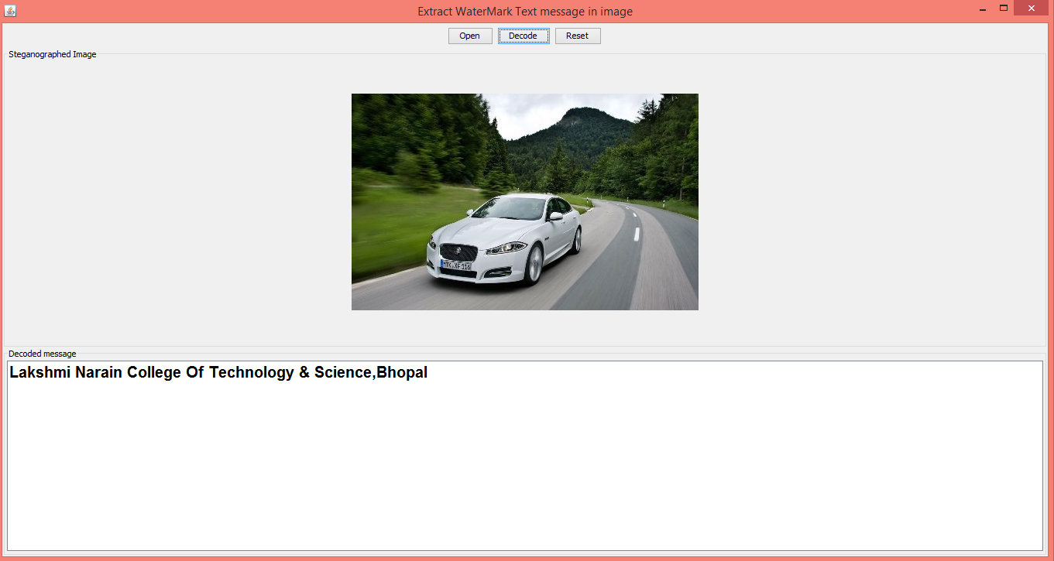
Extraction of Invisible Watermark

Slide 18
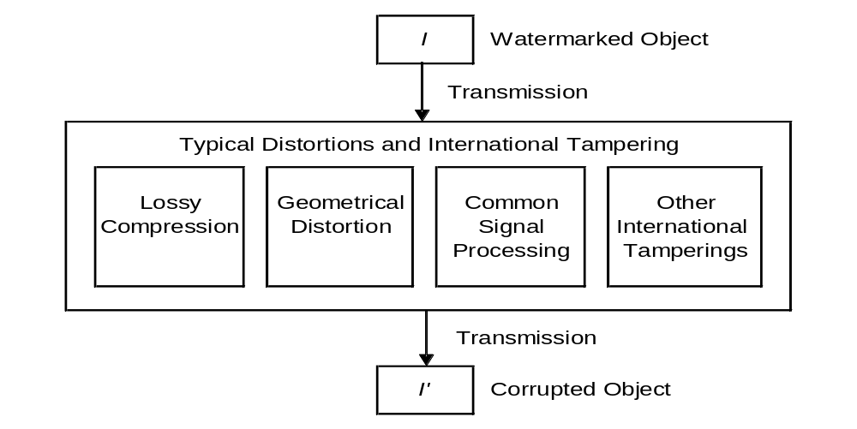
Attacks on Watermark
Figure provided by Cox et al. [1].

Slide 19
Attacks on Watermark
e.g. JPEG/MPEG
Irreversible Data Loss
Quality Degradation

Slide 20
Attacks on Watermark
Specific for images/videos
rotation, translation,
scaling, and cropping operations

Slide 21
Attacks on Watermark
analog-to-digital,
digital-to-analog
conversion, etc.

Slide 22
Attacks on Watermark
Rewatermarking

Slide 23
Desired Characteristics of
Invisible Watermarks
Perceptually unnoticeable
Robust to common watermark attacks
Quality degradation upon removal of watermarks
Unambiguously identifies the owner of the digitized
medium (audio, video, or image).

Slide 24
Advantages & Disadvantages
Advantages:
Not noticeable since the watermarks are spread out.
Can’t be removed without severe quality degradation
since watermarks are inserted at perceptually
significant regions.
Disadvantages:
Original watermark is required in the extraction process.

Slide 25
Conclusion
Spread spectrum watermarking:
Can be used for audio, video, and image files
Meets the desired characteristics of invisible
watermarks – unnoticeable, robust, unambiguous

Slide 26
Thank you!!!

